Slide 1
Introduction

Slide 2
What is a database?
A collection of data.
Typically describing the activities of one or more related organizations.
Models real-world enterprise
Entities
e.g. students, professors, courses, classroom
Relationships between entities
e.g. student's enrollment in courses, professor teaching courses, and use of room for courses.

Slide 3
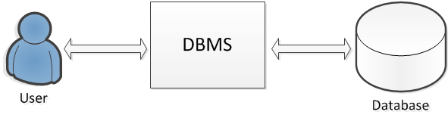
What is a DBMS?
A database management system (DBMS) is a software package designed to assist in maintaining and utilizing large collections of data.

Slide 4
Files vs. DBMS
Suppose a company try to handle a large amount of data in files.
Application must have to handle large amount of data between main memory and secondary storage. Problems include
Buffering
Page-oriented access
Address handling
Special programs to answer different queries.

Slide 5
Must protect data from inconsistency due to multiple concurrent users.
Handle crash recovery.
Restore the system to a consistent state after a crash.
Security and access control.
DBMS is a piece of software designed to make the above tasks easier.
We can use the features of a DBMS to manage the data in a robust and efficient manner.

Slide 6
Advantages of a DBMS
Data Independence
Application program should not be exposed to details of data representation and storage.
DBMS provides an abstract view of the data that hides such details.
Efficient Data access
DBMS can support sophisticated techniques to store and retrieve data efficiently.

Slide 7
Data Integrity and Security
DBMS can enforce integrity constraints.
E.g. check departmental budget before inserting salary information .
DBMS can enforce access controls that govern what data is visible to different classes of users.
Data Administration
Provides facilities for
organizing the data representation to minimize redundancy,
fine-tuning the storage of data to make retrieval efficient.

Slide 8
Concurrent Access and Crash Recovery
DBMS schedules concurrent access such that users can think of the data as being accessed by only one user at a time.
Protects users from the effects of system failures.
Reduced Application Development Time
DBMS supports important functions that are common to many applications.
High-level interface
Facilitates quick application development.

Slide 9
Data Models
A data model is a collection of concepts for describing data, data relationships, and data constraints.
It is a high-level data description constructs that hide many low-level storage details.

Slide 10
Semantic data model
A semantic data model is a more abstract, high-level data model.
For a user to come up with a good initial description of the data in an enterprise.
Entity-relationship (ER) model
A widely used semantic data model.
Allows us to pictorially denote entities and the relationships among them.

Slide 11
id
Customer-street
Customer-name
Customer-city
Loan-number
amount
Borrower
Customer
Loan
An example of an ER model

Slide 12
Relational data model
Most DBMS today are based on the relational data model.
Relation
the central data description construct in this model.
It can be thought of as a set of records.
A table with rows and columns.
Row – a record
Column – field, attribute.

Slide 13
A description of data in terms of a data model is called a schema.
The schema of the above table is
Students(sid: string, name: string, login: string, age: integer, gpa: real)
sid | name | login | age | gpa
53666 | Jones | Jones@cs | 18 | 3.4
53688 | Smith | Smith@ee | 18 | 3.2
53650 | Smith | Smith@math | 19 | 3.8
53831 | Madayan | Madayan@music | 11 | 1.8
53832 | Guldu | guldu@music | 12 | 2.0
An example of a student relation

Slide 14
Levels of Abstraction
The data in a DBMS is described at three levels of abstraction, as illustrated below
View 1
View 2
View 3
Conceptual Schema
Physical Schema

Slide 15
Physical level
how and where data are actually stored, low level data structures are specified at this level.
File organizations and indexes etc.
D43389
C73334
F89328
A34455
C23444
E32399
G29021

Slide 16
Conceptual level (logical level)
describes what data should be stored in the database, and relationship and semantics of the data.
In terms of the data model of the DBMS.

Slide 17
View level (external schema)
Relevant partial view of the database to a particular type of users.
Each external schema consists of a collection of one or more views and relations from the conceptual schema.
A view is conceptually a relation.
But the records in a view are not stored in the DBMS. Rather, they are computed using a definition for the view.
(A view when posting the grade)

Slide 18
Data Independence
Achieved through use of the three levels of data abstraction.
Physical data independence
change of physical database schemas without change of conceptual database schemas or application programs.
Logical data independence
change of conceptual schemas without change of external views.

Slide 19
Languages of DBMS
Data Definition Language (DDL):
A language that specifies data schemas (external and conceptual schemas).
Data Manipulation Language (DML):
A language to facilitate the retrieval, update of data in the database
For retrieval, we query the database with the query language, which is part of the DML.
Usually SQL is used.

Slide 20
People who deal with databases
Database Administrator (DBA) : who has central control over the database and is responsible for the following tasks:
Schema definition/modification,
Storage structure definition/modification,
Authorization of data access,
Integrity constraints specification,
Monitoring performance,
responding to changes in requirements,
Database tuning,
Database Recovery.

Slide 21
Application Programmers –
those who write programs (Cobol, C, Java) with embed DML calls or develop packages with software tools provided by the DBMS vendor.
e.g. programs that generates payroll checks, transfer funds between accounts etc.
Sophisticated users
Those who form request in database query languages.
Naive users
Those who invoke application programs that have been written previously e.g. transfer fund between accounts.

Slide 22
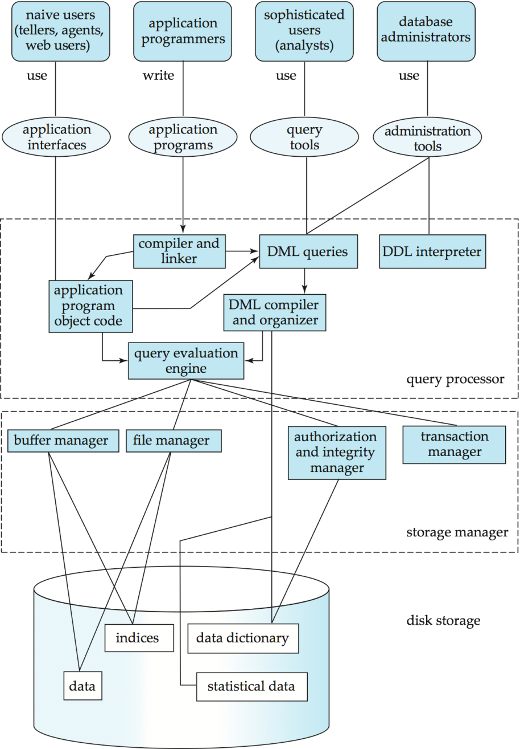
Architecture of a DBMS
Source: Database System Concept, 6th edition

Slide 23
History
The first DBMS was designed by Bachman at GE in early 1960s.
In 1970 Codd at IBM proposed a new data representation framework called the relational data model.
The SQL query for relational databases, developed as part of IBM's System R project, was standardized in the late 1980s.
The current standard was adopted by ANSI (American National Standards Institute) and ISO (International Standards Organization).

Slide 24
In late 1980s and 1990s, several vendors (e.g. IBM's DB2, Oracle 8, Informix UDS) have extended their systems with the ability to store new data types such as images and text.
Specialized systems developed for data warehouses, consolidating data from several databases.
Entering the Internet Age, a new markup language XML is proposed for data access through a Web browser.
As more and more data are collected, companies are also interested to mine useful information from their data (NoSQL database may be used).

